Slide 1
AI ENGINEERING FRIDAYS · THE FAMILIAR FLOW
The familiar Claude Code loop
PLAN MODE
Read + propose
REVIEW
Refine + approve
EXECUTE
Edit + run
VERIFY
Review the result
→
→
→
A strong workflow for bounded work inside one session
AI Engineering Fridays · 1
Notes:
Open with the audience’s normal experience: “You are probably all very familiar with this flow.” In Plan Mode Claude reads and explores without editing source files, presents a plan, and begins editing after approval in the selected permission mode. Say plainly that this is a useful workflow and is not the problem.
Transition: “But what happens when the work is too large for one sitting, starts spawning new work, or needs to move across several sessions?”
[Sources]
- https://code.claude.com/docs/en/permission-modes
- Visual template: Agentic AI workflows — adoption stages + workflow descriptions.pptx
[/Sources]

Slide 2
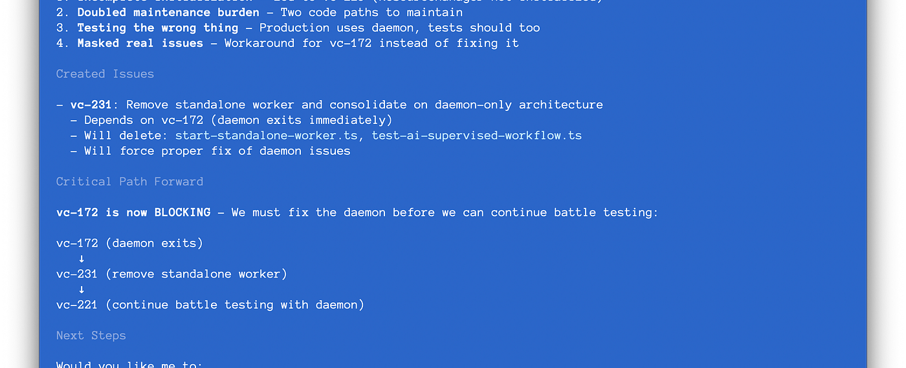
STEVE YEGGE · INTRODUCING BEADS · 2025
605 markdown plan files
“in varying stages of decay” — Steve Yegge
AI Engineering Fridays · 2
Notes:
Now show what “more complex” can become. Steve Yegge did not reject Markdown from the outset: he went all-in on Git-versioned, hierarchical Markdown plans for agent orchestration—and eventually found 605 plan files in varying stages of decay.
Use the screenshot as evidence: the agent has created a follow-up issue, recorded what it depends on, and made the critical path explicit. This is the move from plans as documents to work as queryable state.
Transition: “This pressure grows as we move from an assistant inside one session toward agents working across tasks and in parallel. You may remember this model from the sprint review.”
Accuracy note: the launch essay describes Beads’ historical JSONL implementation. Current technical claims later in the deck use the modern Dolt-based documentation.
[Sources]
- Steve Yegge, Introducing Beads: A coding agent memory system, 13 October 2025: https://steve-yegge.medium.com/introducing-beads-a-coding-agent-memory-system-637d7d92514a
- Original image from the essay: https://miro.medium.com/v2/resize:fit:1400/1*HbBoe7lEio9gX6v6-ZFbZQ.png
- Visual template: Agentic AI workflows — adoption stages + workflow descriptions.pptx
[/Sources]

Slide 3
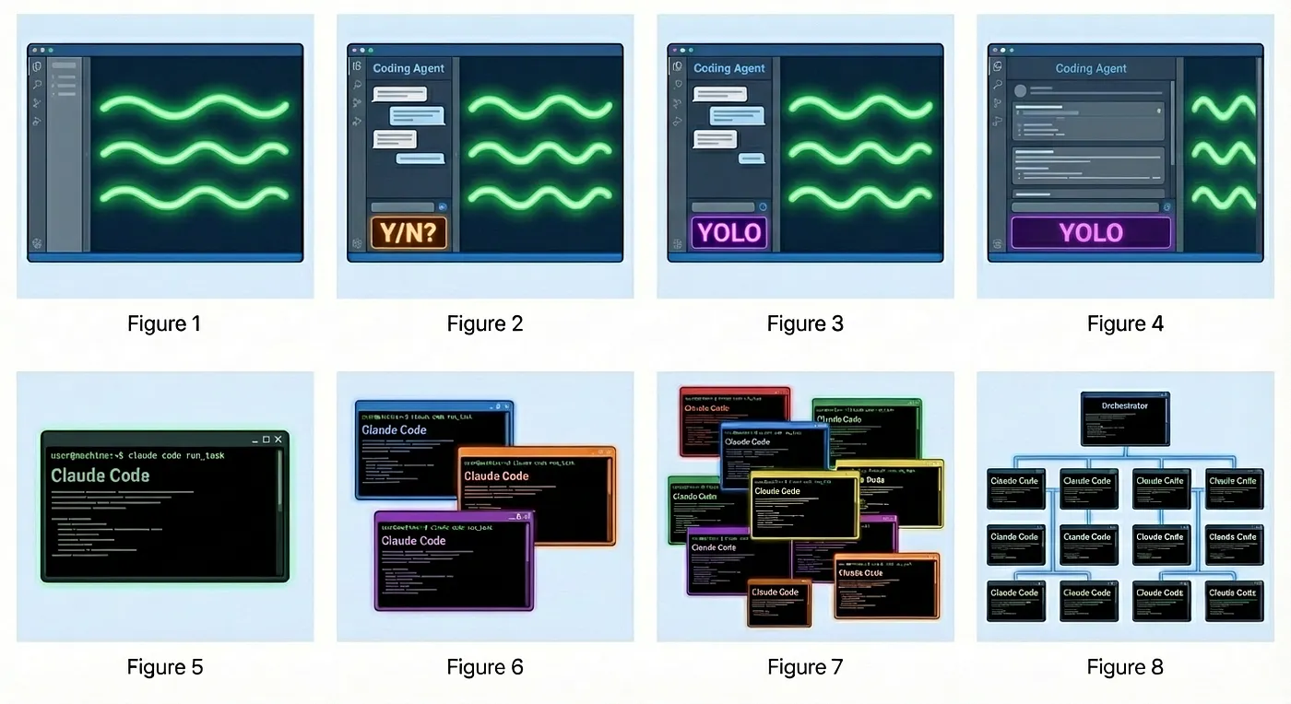
AI CODING WORKFLOW SNAPSHOT · ADOPTION MODEL
The Stages of AI Adoption
AI Engineering Fridays · 3
Notes:
This is the exact adoption-stages slide from the sprint review. Move quickly from left to right: interactive coding assistance, a more autonomous agent, task-bounded agents, then parallel orchestration. Treat it as a useful progression, not a maturity score everyone must climb.
The point for today is narrower: the farther right we work, the more tasks outlive an individual conversation and the more coordination state matters. A native Markdown plan can be enough on the left; durable, queryable task state becomes increasingly valuable as work becomes longer-lived and more concurrent.
Transition: “Even before full orchestration, ordinary engineering work already creates these pressure points.”
[Sources]
- Reused source slide: /Users/paishe01/hNotes/20__Output/Agentic AI workflows — adoption stages.pptx, slide 1
- User-provided asset: yegge-agent-evolution.webp
- Stage model reference: https://justin.abrah.ms/blog/2026-01-08-yegge-s-developer-agent-evolution-model.html
- Brand treatment: https://brandhub.stepstone.com/
[/Sources]

Slide 4
AI ENGINEERING FRIDAYS · THE PRESSURE POINTS
Real work escapes the session
Markdown can carry this—but each pressure adds another convention.
WHAT HAPPENS?
THE PLAN NOW NEEDS
Several sessions
→
State
Work continues tomorrow
New work appears
→
Provenance
Execution reveals a bug
Dependencies
→
A graph
Task B waits for Task A
A hand-off
→
Memory
Another session takes over
IDs · status · ownership · dependencies · provenance · hand-off context
AI Engineering Fridays · 4
Notes:
Let the complexity emerge through questions: What is done? What is next? Where does the bug belong? What is blocked? How does a fresh session know why? Acknowledge that Markdown can encode all of this. The point is that we are progressively designing task-management conventions inside the document.
Connect back to the adoption slide: parallelism is only the most visible version of the problem; continuity, provenance, and dependency tracking begin to matter as soon as work crosses a session boundary.
[Sources]
- Visual template: Agentic AI workflows — adoption stages + workflow descriptions.pptx
[/Sources]

Slide 5
AI ENGINEERING FRIDAYS · BEADS
Beads makes the work state explicit
bd prime
restore context
bd ready
find work
bd show
inspect
bd update
claim + record
bd close
hand off
→
→
→
→
Discovered work becomes a linked bead—not a lost note
AI Engineering Fridays · 5
Notes:
Introduce beads only now. It is a persistent, dependency-aware task graph designed for AI-supervised coding workflows. The agent can restore project context, find unblocked work, inspect one bounded unit, claim it, record discovered work with provenance, and leave a durable hand-off.
[Sources]
- https://github.com/gastownhall/beads/blob/main/docs/index.md
- https://github.com/gastownhall/beads/blob/main/docs/getting-started/ide-setup.md
- https://github.com/gastownhall/beads/blob/main/docs/multi-agent/coordination.md
- Visual template: Agentic AI workflows — adoption stages + workflow descriptions.pptx
[/Sources]

Slide 6
AI ENGINEERING FRIDAYS · LIVE DEMO
A short beads loop
A fresh session can recover context and leave the next one a clean hand-off.
COMMAND
RESULT
bd prime
1
Orient
Load workflow + project memory
bd ready
2
Choose
Find work with no open blockers
bd show <id>
3
Understand
Inspect one bounded task
update · create · close
4
Continue
Act, record discoveries, hand off
The task graph survives even when the conversation does not.
AI Engineering Fridays · 6
Notes:
Switch to the terminal. Run the prepared demo from presentation/demo-runbook.md. Keep this to roughly three minutes. If the live agent response stalls, use the deterministic CLI path and continue; the audience still sees the same persisted context and task graph.
[Sources]
- https://github.com/gastownhall/beads/blob/main/docs/index.md
- Local demo runbook: presentation/demo-runbook.md
- Visual template: Agentic AI workflows — adoption stages + workflow descriptions.pptx
[/Sources]

Slide 7
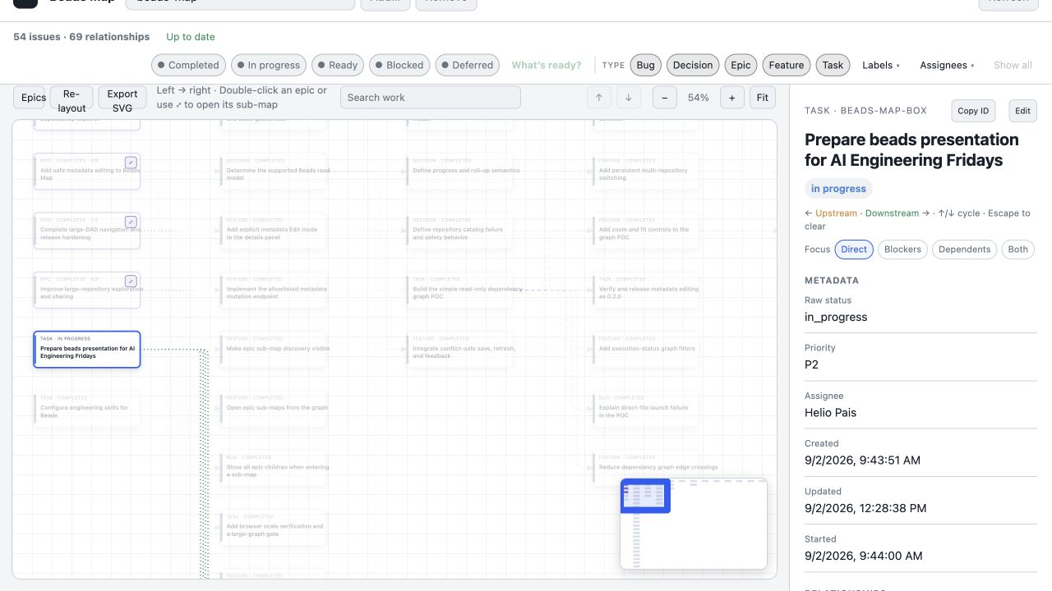
AI ENGINEERING FRIDAYS · BEADS MAP
Beads Map makes the hand-off visible
AI Engineering Fridays · 7
Notes:
Show the presentation task selected with its children, state, description, acceptance criteria, design, and notes. The opening slide already established the repository-level view; here, zoom into one durable hand-off.
[Sources]
- Local screenshot captured from beads-map on 2026-09-02: presentation/assets/beads-map-presentation-work.png
- Visual template: Agentic AI workflows — adoption stages + workflow descriptions.pptx
[/Sources]

Slide 8
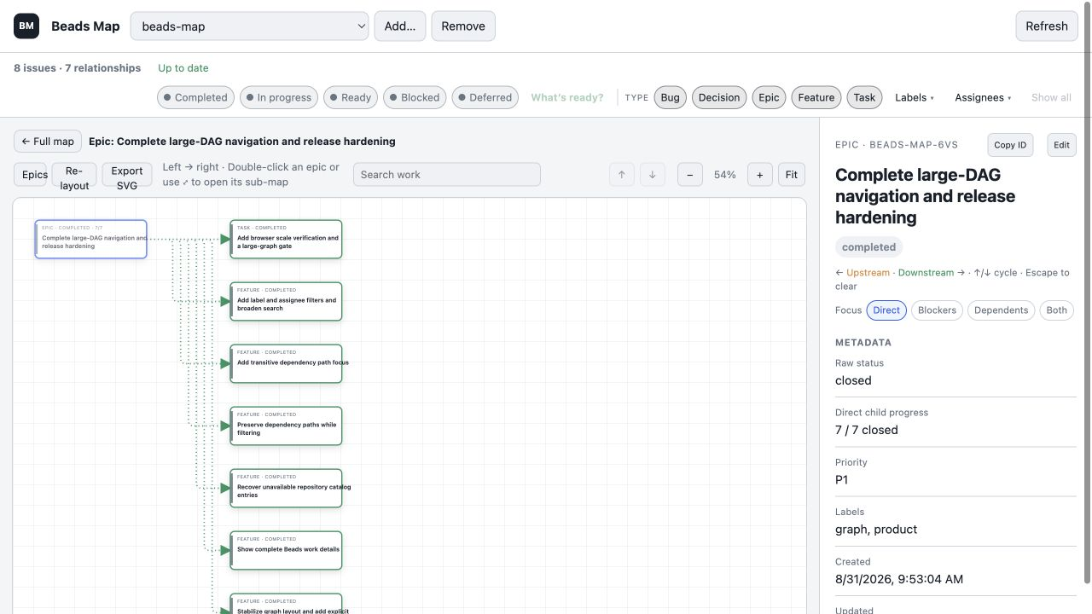
AI ENGINEERING FRIDAYS · PROOF
49 completed beads in seven days
AI Engineering Fridays · 8
Notes:
This is not a benchmark or a causal productivity claim. It is a traceable project history: 49 beads were closed between 25 and 31 August 2026, spanning product decisions, implementation, bugs, packaging, and release hardening. The visualizer shown here was built through the system it visualizes.
Transition: “Now the team question—and our Git server changes the answer. StepStone uses Bitbucket, so Beads’ native Dolt remote transport is not available to us.”
[Sources]
- Local bd stats and closed-issue records inspected 2026-09-02
- Local screenshot captured from beads-map on 2026-09-02: presentation/assets/beads-map-release-hardening.png
- Visual template: Agentic AI workflows — adoption stages + workflow descriptions.pptx
[/Sources]

Slide 9
AI ENGINEERING FRIDAYS · BITBUCKET
At StepStone, Git carries the hand-off
Developer /
agent A
local Dolt DB
pre-commit
export
.beads/
issues.jsonl
in Git
post-merge
import
Developer /
agent B
local Dolt DB
→
→
→
→
Bitbucket carries the exported hand-off—not the database or live state
AI Engineering Fridays · 9
Notes:
For StepStone, the answer is a qualified yes through a Git-mediated compatibility workflow—not through Beads’ native Dolt remote sync.
Each clone still works from its own local Dolt database. Before commit, a hook exports issue records to .beads/issues.jsonl. Git and Bitbucket carry that ordinary text file. After merge or checkout, another hook imports the JSONL into the receiving clone’s local database. A fresh clone can use bd bootstrap.
Keep the distinction explicit: JSONL is the exported interchange and hand-off medium, not the live database or Beads’ canonical wire protocol. Collaboration happens at commit/push/pull time rather than as live synchronization. Export and staging are opt-in, and hooks must be installed or configured in every working copy.
Never commit .beads/embeddeddolt/ or .beads/dolt/. The binary database is not mergeable. Memories are excluded from issue export by default and should not be put into a shared repository without a deliberate team policy.
[Sources]
- StepStone Bitbucket/Stash transport constraint supplied by Helio Pais on 2026-09-03
- https://github.com/gastownhall/beads/blob/main/docs/core-concepts/sync-concepts.md
- https://github.com/gastownhall/beads/blob/main/docs/reference/configuration.md
- https://github.com/gastownhall/beads/blob/main/docs/reference/git-integration.md
- https://github.com/gastownhall/beads/blob/main/docs/cli-reference/bootstrap.md
[/Sources]

Slide 10
AI ENGINEERING FRIDAYS · IN PRACTICE
The hand-off travels with the code
One pull request carries the implementation and its Beads hand-off.
HAND-OFF
RESULT
Agent A claims
1
Owned
bd update BEAD-123 --claim
Commit exports
2
Versioned
.beads/issues.jsonl refreshed
PR merges
3
Reviewable
code + task state in Bitbucket
Agent B resumes
4
Restored
git pull · import · bd prime
Hooks automate the round trip; same-bead edits may still need reconciliation.
AI Engineering Fridays · 10
Notes:
Walk the audience through one asynchronous hand-off.
1. Agent A claims or updates a bead in the local database.
2. The repository’s pre-commit hook exports the current issue records and stages .beads/issues.jsonl.
3. The pull request carries code and task state together through Bitbucket review.
4. Agent B pulls the merged work; the compatibility hook—or an explicit bd import .beads/issues.jsonl—hydrates the local database, and bd prime restores the working context.
Hash-based IDs make independently created beads coexist well across branches. Concurrent edits to the same bead are less automatic: import is an upsert with timestamp rules, not a semantic three-way merge. If Git reports a JSONL conflict, preserve both lines, import, inspect the affected beads, and export again. A union merge driver can reduce line-level conflict markers, but the result still needs verification.
The operational promise is deliberately modest: the hand-off is reviewable in Git and queryable again in Beads. It is not live state, and JSONL does not reproduce Dolt history, branches, or deletion semantics.
[Sources]
- https://github.com/gastownhall/beads/blob/main/docs/cli-reference/export.md
- https://github.com/gastownhall/beads/blob/main/docs/cli-reference/import.md
- https://github.com/gastownhall/beads/blob/main/docs/core-concepts/hash-ids.md
- https://github.com/gastownhall/beads/blob/main/docs/reference/git-integration.md
- https://git-scm.com/docs/gitattributes
[/Sources]

Slide 11
AI ENGINEERING FRIDAYS · YOUR TURN
Try it—and let me know
Start with one real task that will still matter tomorrow.
FIRST EXPERIMENT
OUTCOME
Install
1
Once
brew install beads
Initialize
2
Scope
bd init inside one repository
Resume
3
Context
bd prime in a fresh session
Tell me
↗
Feedback
What worked? What got in the way?
Use beads where the work—not merely the chat—needs continuity.
AI Engineering Fridays · 11
Notes:
Close after the practical Bitbucket hand-off, without overselling. Ask people to try Beads on one genuine multi-session task—solo or through one small pull request—and tell you where the explicit export/import convention helps or adds friction. Leave the final slide visible for questions.
[Sources]
- https://github.com/gastownhall/beads/blob/main/docs/index.md
- Visual template: Agentic AI workflows — adoption stages + workflow descriptions.pptx
[/Sources]

